Slide 1
Digital Communication 22EC2208
AY 2023-24
Delta Modulation and Demodulation

Slide 2
Digital Communication
Dr. M. Venu Gopala Rao
M.Tech, Ph.D(Engg) F.I.E.T.E, L.M.I.S.T.E, I.S.O.I., I.A.E., S.S.I.
Cert. in R.S.T ( City & Guild’s London Institute , London)
Professor, Dept. of ECE, K L University
mvgr03@kluniversity.in

Slide 3
Delta Modulation
Delta modulation is a simplified version of DPCM:
* The prediction filter is first order
* The quantizer is two level ±Δ
High sampling rate
Analog signal is approximated by staircase function
Only a single binary digit is required for each sample
DM uses very simple hardware and is low cost for that reason.

Slide 4
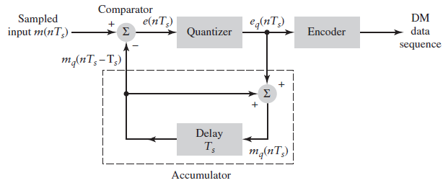




Delta Modulation
1 bit
±Δ
DM Transmitter

Slide 5
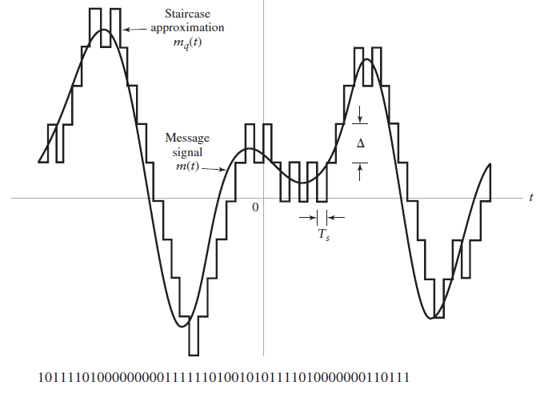

Slide 6
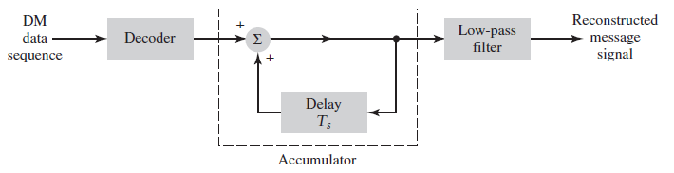
Receiver

Slide 7
Quantization errors in DM
For effective DM, the parameters to be accounted are:
Step Size (delta)
Sampling Rate (fs)
To have faster change in the signal, both must be increased
But if we increase fs, Bandwidth also increases
And increase in delta increases quantization error
By choosing of wrong step size leads to two issues:
Slope Overload Distortion (When input signal is fast varying, step size is small)
To avoid slope overload distortion, Choose Larger step size or increase fs
Granular Noise (When input signal is slow varying, step size is large)
To avoid Granular Noise, Choose smaller step size

Slide 8
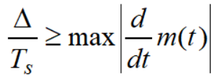
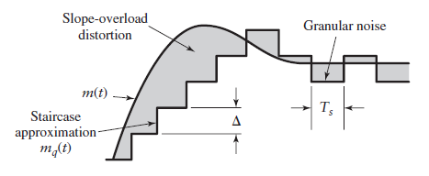
Slope overload distortion
Step size is too small
The condition for no over slope distortion is
Step size is too small

Slide 9
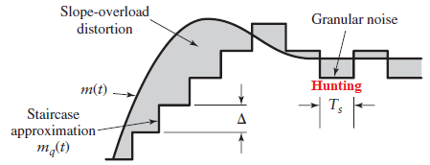
Granular noise
The step size is too large

Slide 10
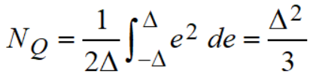
Quantization Noise in DM
e_{q}(n)
SQNR can not be calculated directly in DM due to the distortions
+Δ
In PCM, variance = (Delta)^2/12
For DM, step size = 2*Delta
(since Delta –(-Delta))
Therefore variance = 4*(Delta)^2/12
= (Delta)^2/3
e(n)
-Δ

Slide 11

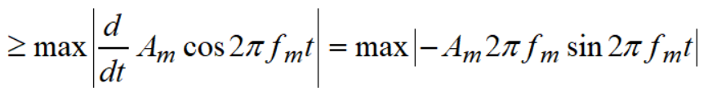

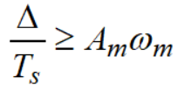
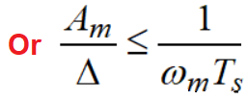
SQNR for DM
Consider an input signal
The condition for no slope overload distortion

Slide 12
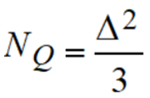
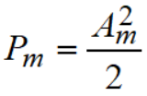
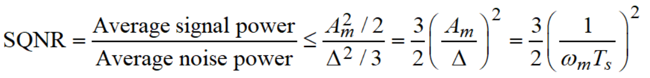
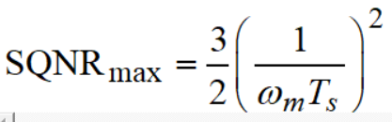

SQNR for DM…
The quantization noise power
The signal power
Then the Signal Quantization Noise Ratio
Does not depend on amplitude

Slide 13
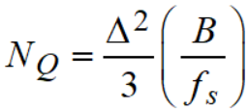
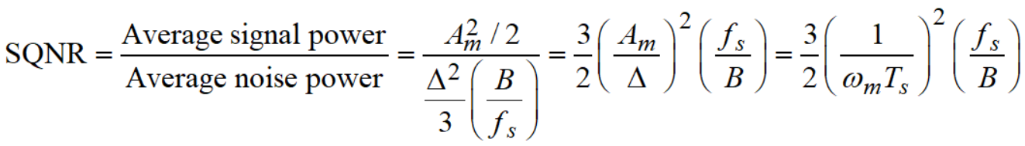
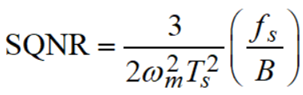

With the post reconstruction filter
Let the cut-off frequency of LPF at the receiver output be equal to message signal bandwidth ‘B’ Hz.
Then the noise power at the receiver output
Then the Signal Quantization Noise Ratio

Slide 14
End

